Slide 1
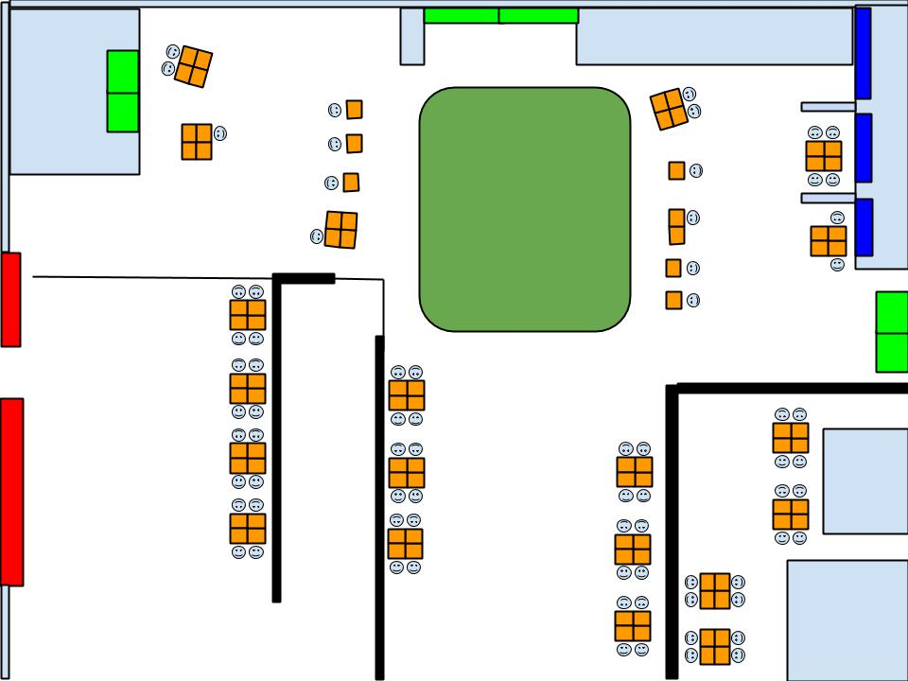
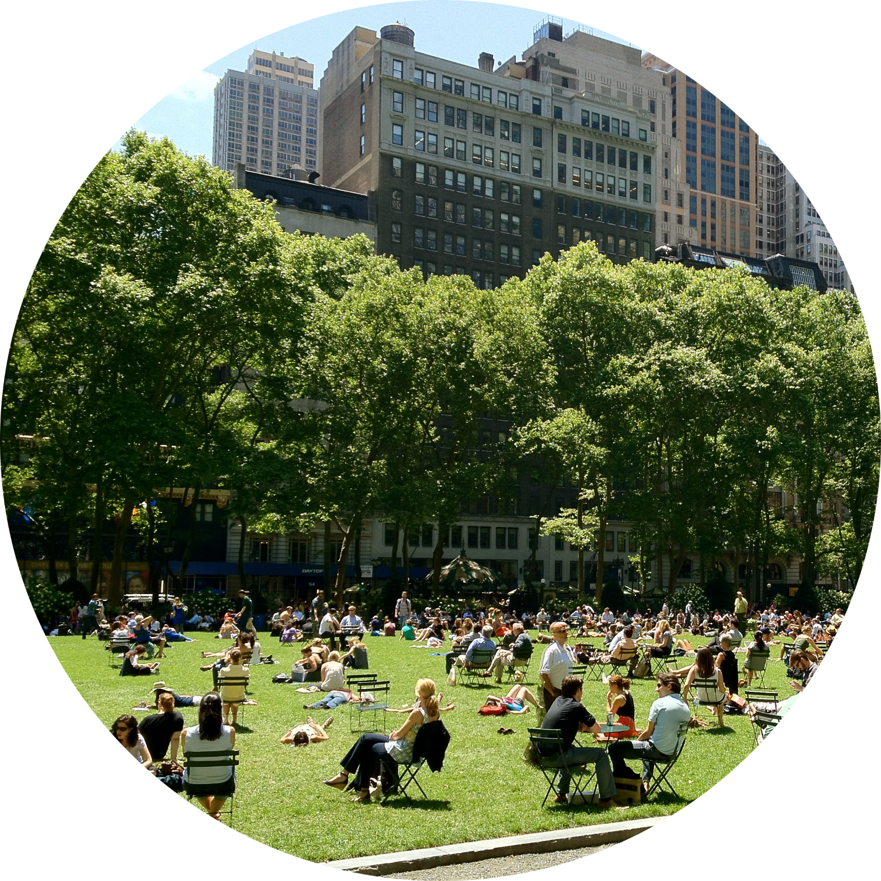
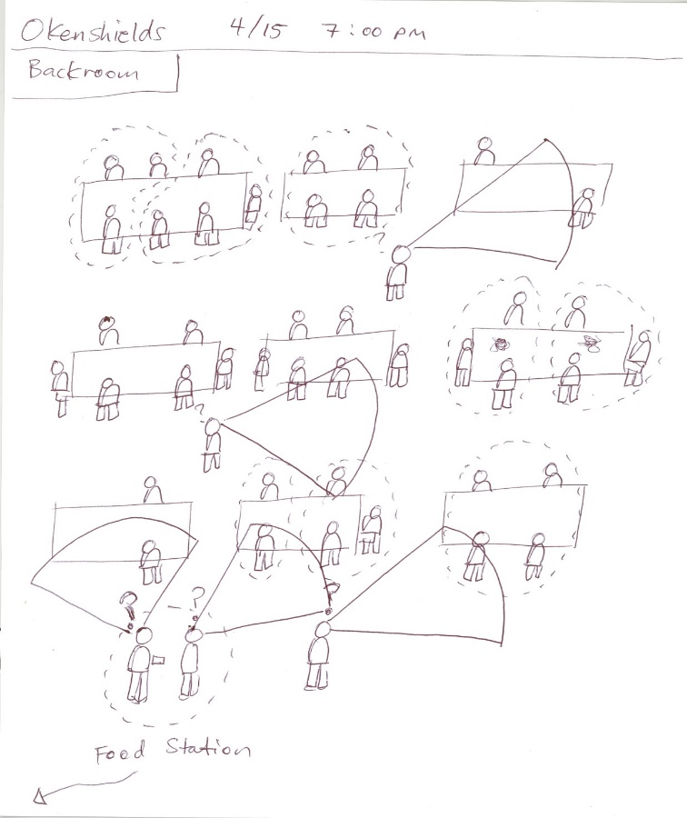
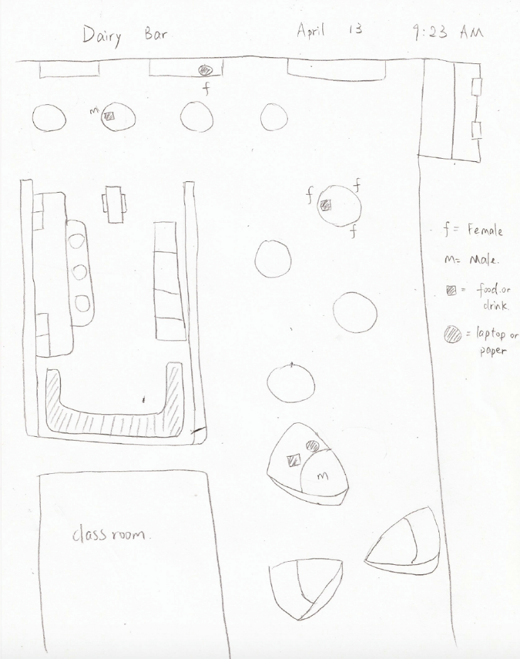
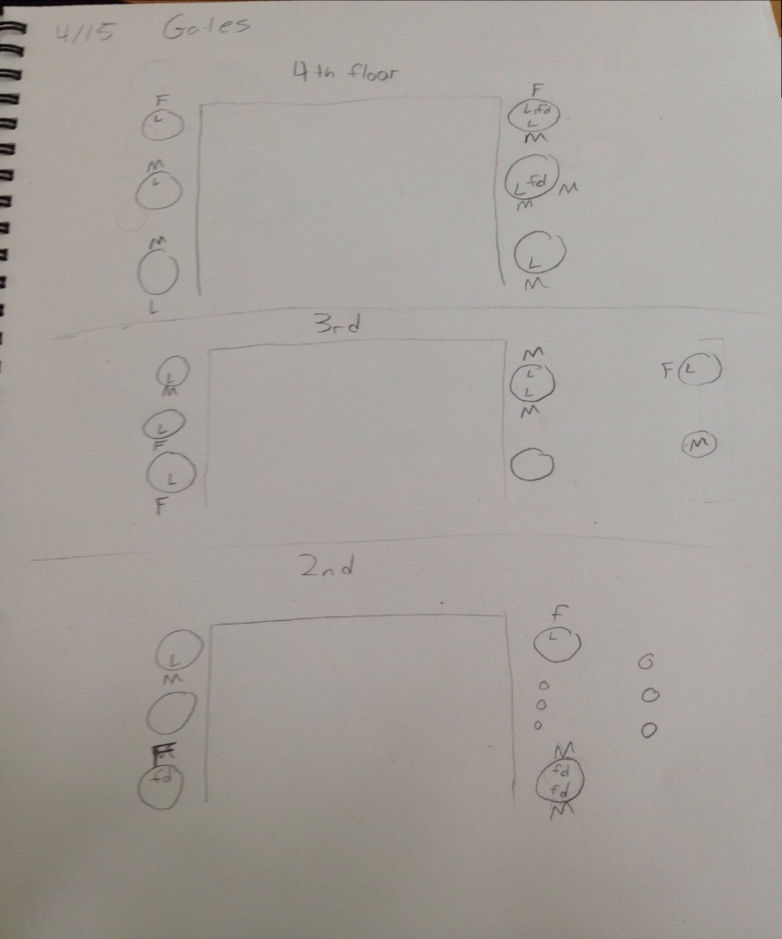
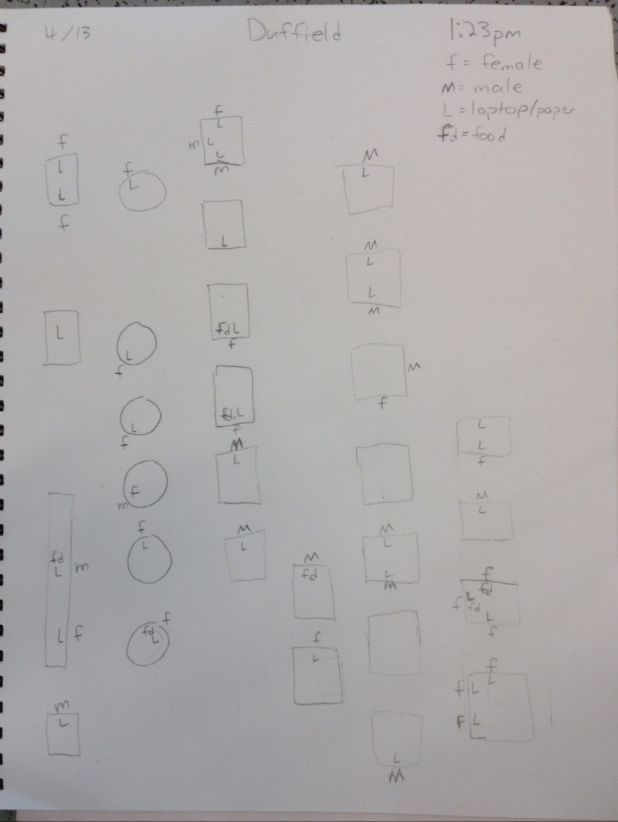
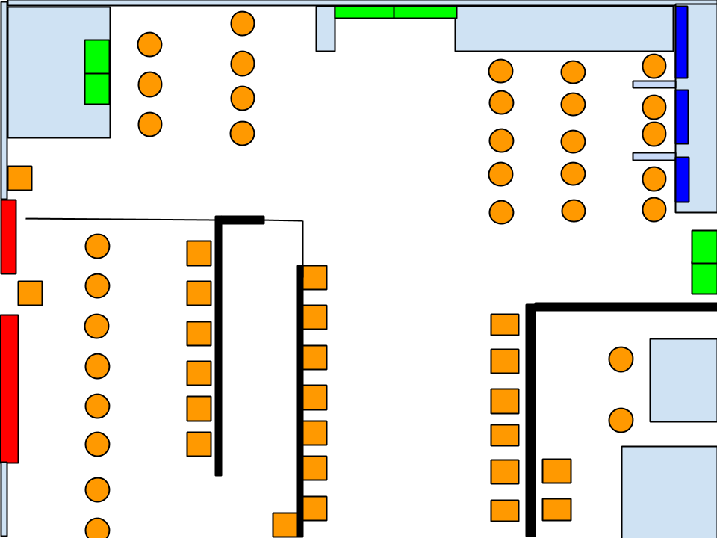
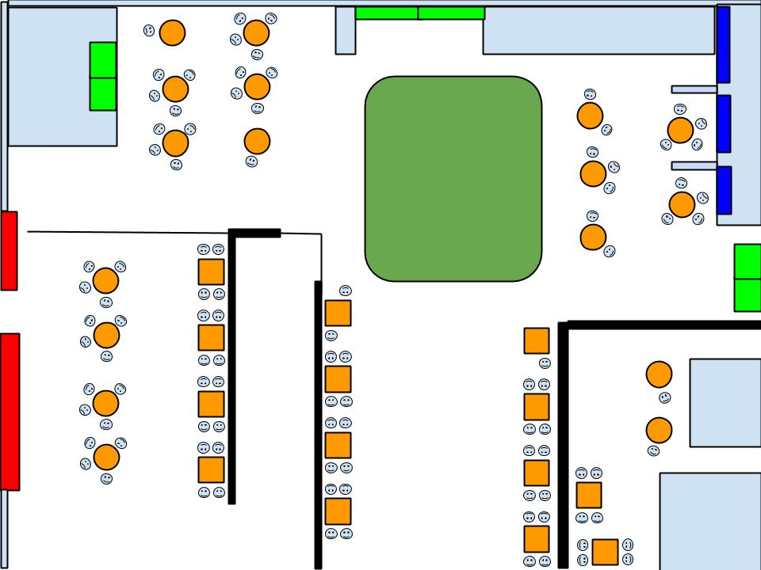
Seating in Crowded Indoor Areas
Jacques Diec (jpd276), Ashton Hsu (amh333), Tri Hoang (tmh252), and Wodan Zhou (wz262)
Cornell University
Introduction
Methods
Results and Conclusions
During high peak hours, indoor public places at university campus become extremely crowded and it is difficult to find seating for both groups and individuals. The consequence is that many people choose to avoid certain places because they usually have a difficult time finding seats. We hope to solve the problem of finding a seat in privately owned indoor public spaces during crowded hours by exploring technical and social solutions.
One of our most consistent observations was the inefficiency in the use of space in seating areas in public places on campus. To address this, we designed tables that could be put together and taken apart (Lego tables). The size of each individual table is reduced to accommodate one person. For groups of two or more people, the tables could be pieced together to form larger tables. This eliminates the issue of excess space that is usually present in standard tables that are not fully occupied.
Transfer Scenario
Participatory Design
Feminist HCI
Design Wickedness
By allowing users to interact
and move tables around to their
preference, we are allowing users
to create a seating arrangement
that they prefer. We predict that by
allowing users to change the
arrangement of seats whenever
they want, public indoor spaces
will be able to hold more people
since users will feel more
comfortable with their
seating arrangements.
Our revised model accommodates
for major disabilities such as walking-
impairment and blindness. Each block
(individual table) has a unique
identification number and is equipped
with a rechargeable battery. The
disabled user registers this number
into his phone. The table block
then uses an indoor localization
algorithm known as triangulation to
predict the approximate location of the
user and directs the table to follow
them to their destination.
Accommodating for people
with disabilities introduced
a new problem, particularly
because of the existence of
obstacles (e.g. people and
furniture) that may obstruct
or collide with the moving
table.
We studied the outdoor seating situation at Bryant Park, a 9.6-arc public park in Manhattan. Bryant Park’s tables
and seats are located around
“The Great Lawn”, which captures the attention of visitors. This minimizes the “awkwardness” of sitting near strangers, now that everyone shared a common spectacle.
R-1: Duffield with lawn and lego tables
Users in the Lego tables setting surprisingly didn’t choose to detach smaller tables to sit. Some of them even quit finding seats and decided to go somewhere else.
➣ It might seem that the lawn would take much space of Duffield but the setting is proven to encourage users to sit at tables surround the lawn even if someone already sat there. Many of them actually preferred to sit on the lawn.
➣ The combination of both lawn and Lego tables gave the best result. Users who chose to go to different places at previous scenarios would now detach tables to sit around the lawn. They were also willing to sit next to strangers.
Students:
We placed a large emphasis on students which are the main users and made up the majority of users. We found that it seems hard to find seats at indoor public places is not because of the lack of tables and chairs; the problem is students prefer to have their own space when sitting in public places. Therefore, even if there are available spots at preoccupied (1-2 people) tables, they still choose not to seat there.
Professors:
We interviewed professors about whether they think it is difficult to find seats at Dairy Bar. Dairy bar tables can only fit at most 5 people. He usually sits by himself everyday to eat but sometimes he will bring students with him. Every time he goes there, they are students all around the place, studying, having lunch or discussing about the projects. It is worth noting that he usually likes to sit by himself and will only sit with students on occasion.
Field Observations
Cornell Dairy Bar
Gates Hall
Duffield Hall
User Interviews
Okenshields Dining Hall
During high peak hours, indoor public places at university campus become extremely crowded and it is difficult to find seating for both groups and individuals. The consequence is that many people choose to avoid certain places because they usually have a difficult time finding seats. We hope to solve the problem of finding a seat in privately owned indoor public spaces during crowded hours by exploring technical and social solutions.
Future Steps
Next Steps: We will continue to conduct user interviews to narrow down our design to the seating approach that will be best received.
Limitations: We used paper prototype to simulate people’s decisions to choose seats in indoor public spaces. If we had enough resources, we would have actually created our tables and tested them out on users. This would have immersed the user in the indoor public space which would have produced more accurate behavior than our simulated user testing setup.
User Testing
UT-1: Normal Duffield
UT-2: Duffield with Lawn
R-1: Duffield with lawn and Lego tables
We built 4 floor-plan paper prototype: normal Duffield, Duffield with lawn, Duffield with Lego tables, Duffield with lawn and Lego tables. Tables and people are represented in paper cutouts.
All objects are color-coded. For example: orange for tables, blue for strangers, etc.
Users were given a task to find a seat and place their icon (yellow smiley face) accordingly to different prototypes. They always have the option to quit and go somewhere else.
The testing order was normal Duffield, Lego tables, lawn, Lego tables and lawn.
Users’ emotional and verbal response to the “why question” was recorded

